Slide 1
Welcome to our final project presentation

Slide 2
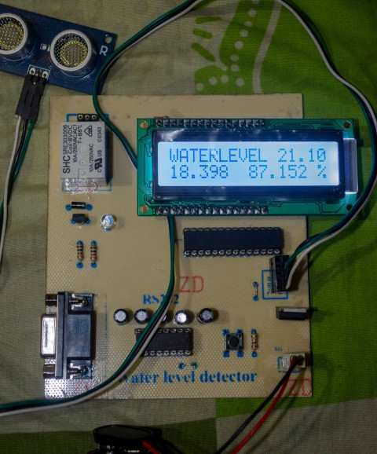
Presentation on
Design and Implementation of Water pump automation system

Slide 3
A Project submitted
By
Sudipto, Roy (ID: 10-17252-2)
Rajib, Dey (ID: 10-17225-2)
Chowdhury Mohammed ,Riajul Islam (ID: 10-16258-1)
Aditi Anika Wardia (ID: 10-15542-1)
Under the supervision
Of
Kamrul Hassan
Supervisor
Lecturer, Faculty of Engineering
&
Dr. M. Tanseer Ali
External Supervisor
Assistant Professor, Faculty of Engineering

Slide 4
Outlines
Introduction
Why Automation ?
Project Aims
Benefits
Basic Principle
Block Diagram
Main Hardware Parts
Main Components used
Description of the Hardwires used
Circuit Diagram
Working Principle
PCB Circuit Design
Result Analysis
Extension of the project
Future work
Conclusion

Slide 5
Introduction
Water pump automation system is the technology of automatically collecting status data from the water tank metering devices and transferring that data to a water pump controlling system. Which will turn the motor on or off depending upon the water level in the tank.
This technology mainly saves the hassle to physically check the water tank on our roof-top and turn the water-pump on/off , which in addition helps us avoid wastage of water.

Slide 6
Why Automation?
Automation or automatic control is the use of various control systems for operating equipment such as machinery, processes in factories and other applications with minimal or reduced human intervention.
The biggest benefit of automation is that it saves labor.
It is used to save energy and materials .
To improve quality, accuracy and precision.

Slide 7
Project Aims
Design and implementation of automated water level control system.
  Microcontroller operated.
To implement extra functionality using sensors i.e. Ultrasonic Distance Sensor.
Upgradation of typical water pumping system.
cost effective and a reliable system.

Slide 8
BENEFITS
The benefits of this projects are –
Saves water
Saves time
No need of any human intervention for a long time after the installation
Saves Electricity by switching the motor off at the correct time
Helps preventing a mess by stopping the overflow of water
Lecture 1

Slide 9
BASIC PRINCIPLE OF THE PROJECT AND DESIGN
In our project the inbuilt automated water height measuring system powered by ultrasonic distance sensor monitors the water height in the tank.
The Microcontroller displays the water height (In Inches) in the LCD and while the water height changes in the tank it then displays the water height in percentage also.
According to this percentage value of the height of the water, the Microcontroller drives the motor on/off through a relay.
Lecture 1

Slide 10
Block Diagram of Water pump automation system
Micro
controller
( ATmega8)
PING)))™ Ultrasonic Distance Sensor
16 X 2 LCD
Relay
Water Tank
Motor

Slide 11
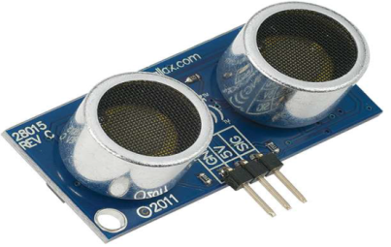
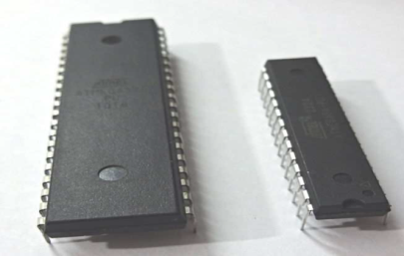
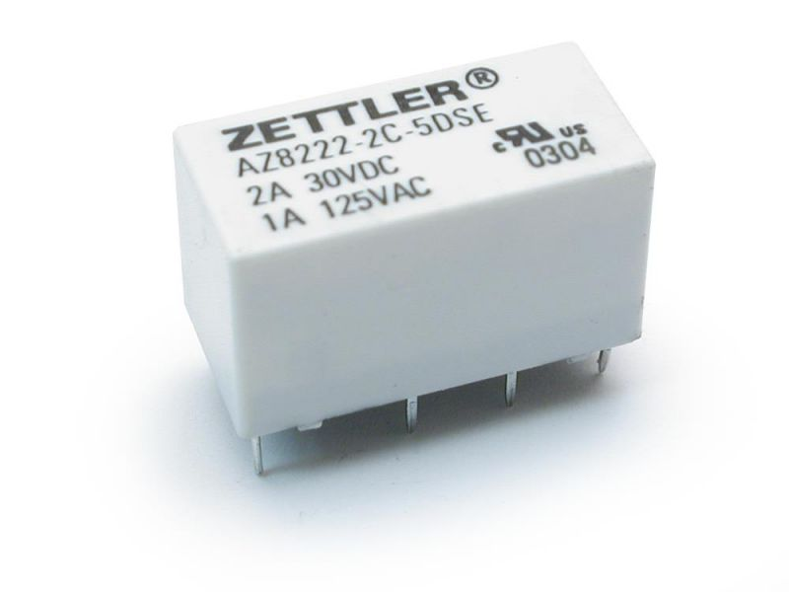
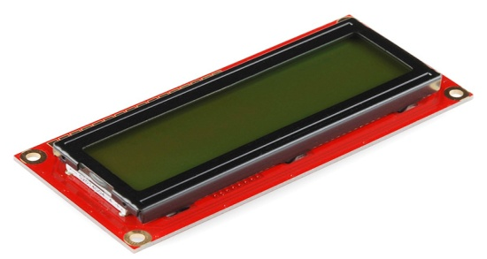
Main hardware parts
PING)))™ Ultrasonic Distance Sensor (#28015)
Microcontroller (ATmega8)
Relay
16x2 LCD

Slide 12
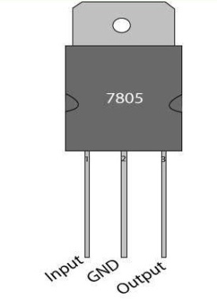
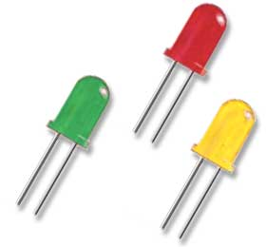
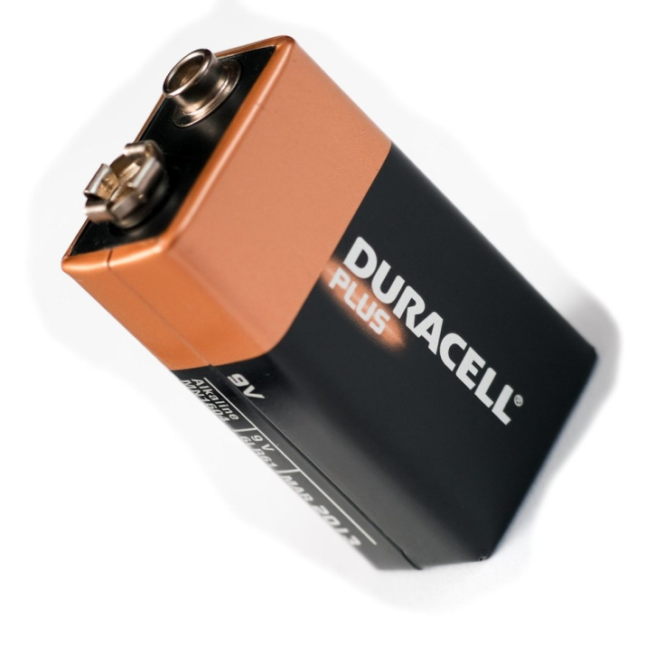
Miscellaneous Components Used
LED
Battery - 9V
Linear Regulator IC 7805

Slide 13
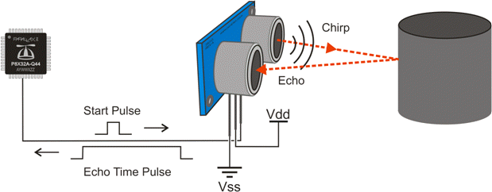
PING)))™ Ultrasonic Distance Sensor (#28015)
The Parallax PING))) ultrasonic distance sensor provides precise, non-contact distance measurementsfrom about 2 cm (0.8 inches) to 3 meters (3.3 yards).
The PING))) sensor detects objects by emitting a short ultrasonic burst and then "listening" for the echo. Under control of a host microcontroller (trigger pulse), the sensor emits a short 40 kHz (ultrasonic) burst.

Slide 14
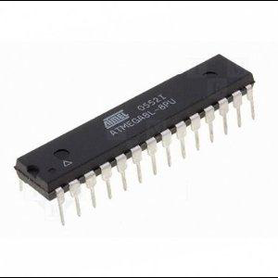
Microcontroller
A microcontroller (sometimes abbreviated µC, uC or MCU) is a small computer on a single integrated circuit containing a processor core, memory, and programmable input/output peripherals.
The ATmega8 is a low-power CMOS 8-bit microcontroller based on the AVR RISC architecture. By executing powerful instructions in a single clock cycle, the ATmega8 achieves throughputs approaching 1 MIPS per MHz, allowing the system designer to optimize power consumption versus processing speed.
Lecture 1

Slide 15
Relay
A relay is an electrically operated switch. relays use an electromagnet to operate a switching mechanism mechanically .Relays are used where it is necessary to control a circuit by a low-power signal (with complete electrical isolation between control and controlled circuits), or where several circuits must be controlled by one signal.

Slide 16
16x2 LCD
LCD (Liquid Crystal Display) screen is an electronic display module and find a wide range of applications.
A 16x2 LCD means it can display 16 characters per line and there are 2 such lines. In this LCD each character is displayed in 5x8 pixel matrix.
The command register stores the command instructions given to the LCD
The data register stores the data to be displayed on the LCD.

Slide 17
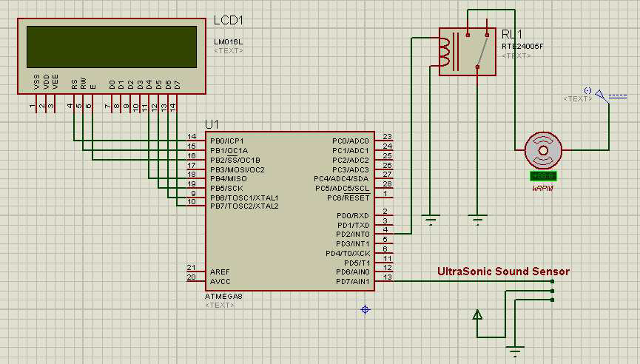
Circuit Diagram of Water pump automation system

Slide 18
Working Principle
Measuring the height
When the sensor starts transmitting then the sonar sensor sends a “high” to the microcontroller
the ultrasonic wave is bounced back to the receiver part of the sonar sensor then the sensor makes this “high” signal into a “low” one
The microcontroller calculates the time between this one high and low pulse

Slide 19
Working Principle
Setting up the project for one particular water tank
When we are done with measuring the tank height then we will save this value onto an EEPROM by pressing the store button.
the LCD will display the sentence “Data Stored”.
We can use one set of this project in many water tanks , but at first we have to do the measuring and saving the empty water tank height to the EEPROM first.
Making the relay on/off
relay on when the water height goes down below 10% and relay off when the water height is above 90%.

Slide 20
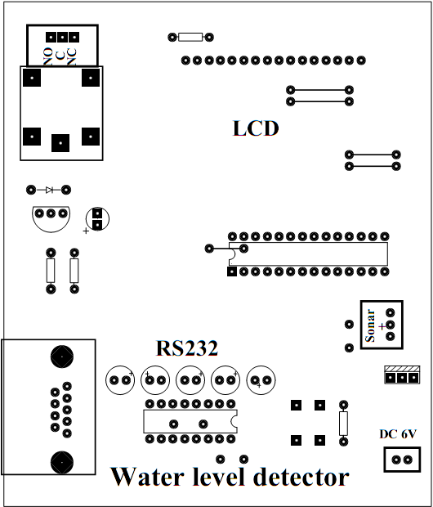
PCB Circuit Design( Top part)

Slide 21
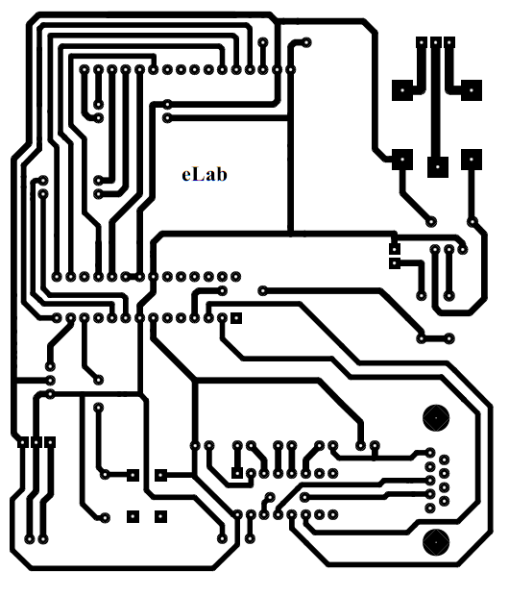
PCB Circuit Design(Bottom part)

Slide 22
RESULT ANALYSIS
We tested the project in rooftop water tanks and it worked just fine. Here is a demonstration of the project on a plain floor, which will represent the water surface in the water tank.
 | Tank Height (Inch) | Current height value (Inch) | Water Height (Tank Height – Current value) (Inch) | Percentage value ( How much of the tank is empty ) | Machine ON or OFF
1 | 42.96 | 42.41 | 0.55 | 98.718% | ON
2 | 42.96 | 27.52 | 15.44 | 64.050% | ON
3 | 42.96 | 3.932 | 39.028 | 9.1510% | OFF

Slide 23
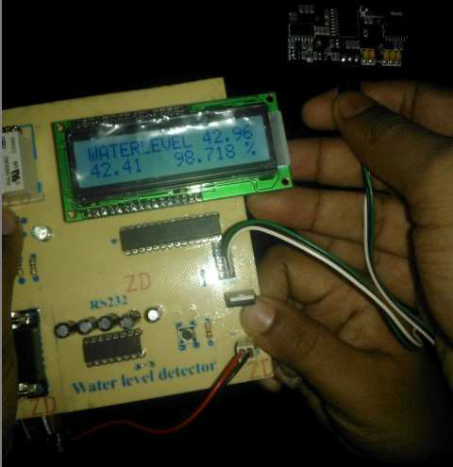
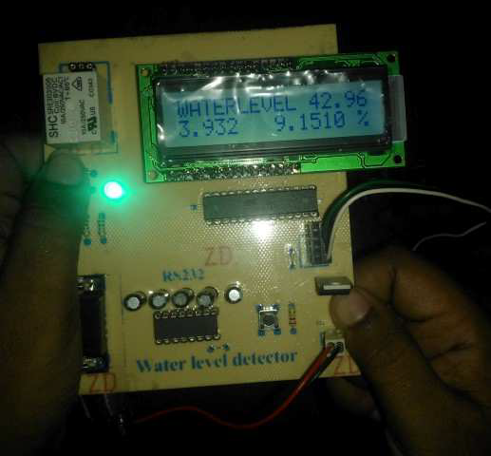
An almost empty Water tank An almost filled Water tank

Slide 24
Extension of the Project
As an extension of the project we have added a feature through which the water level can be observed on User’s PC through the USB Serial port via a PC Program written exclusively for this project on C#

Slide 25
Future Work
Auto & Manual Start
Wireless Sensor
For reserve tank or Multiple tanks
For Multiple Motors

Slide 26
CONCLUSION
Water is one of the most important basic needs for all living
beings. But unfortunately a huge amount of water is being wasted
by uncontrolled use. Some other automated water level
monitoring system is also offered so far but most of the method
has some shortness in practice
We have successfully experiment the system and analyzed
the results. The microcontroller-based water pump automation
system provided a very satisfactory performance with a
minimal percentage of error. Using this automation system,
one can save manpower. This could have a substantial benefit
from this project for efficient management of water.

